Slide 1
pGLO Transformation LAB AP LAB 8
araC
ori
pGLO
GFP
bla
BIO-RAD lab book
http://www.mshri.on.ca/nagy/GFP%20mice.jpg

Slide 2
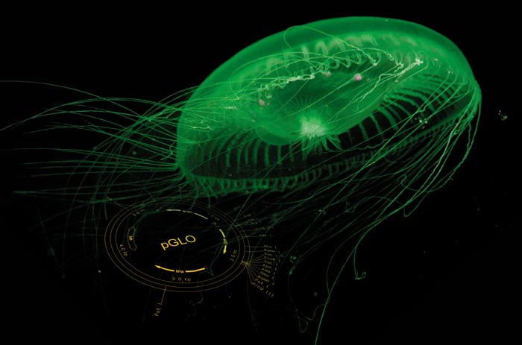
Aequorea victoria:
Source of “glowing gene” for this experiment

Slide 3
NPR Jellyfish Protein Researchers Win Chemistry Nobel
http://www.npr.org/templates/story/story.php?storyId=95517508

Slide 6
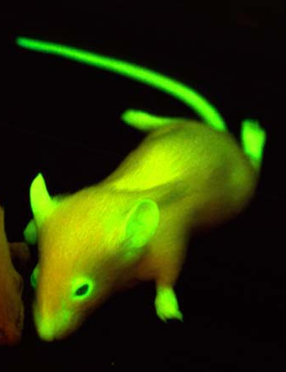
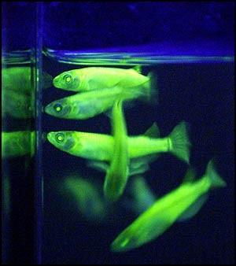
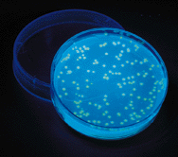
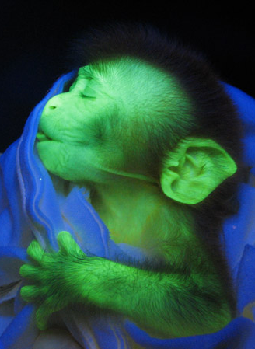
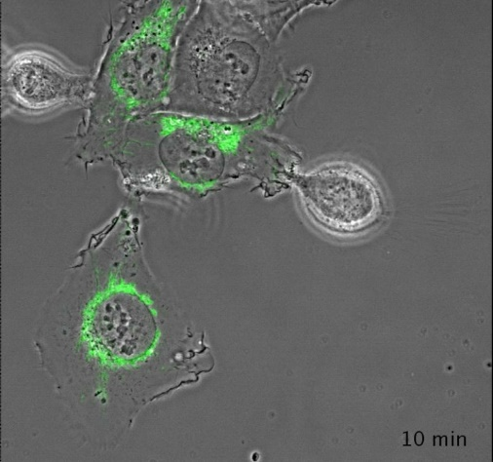
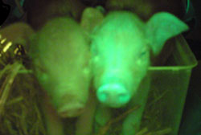
Jellyfish (GFP) gene transformed into other organisms
http://www.lafuga.de/GFP_pig.jpg
http://www.technologyreview.com/files/21291/monkey_x600.jpg

Slide 7
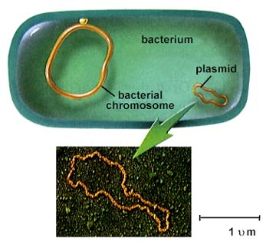
PLASMID
Extrachromosomal DNA
Often carry genes for antibiotic resistance
Can be passed from one bacterium to another
http://www.agen.ufl.edu/~owens/age2062/OnLineBiology/OLBB/www.emc.maricopa.edu/faculty/farabee/BIOBK/14_1.jpg

Slide 8
Bacterial Transformation
The uptake of DNA
Bacterial Cell
Chromosomal
DNA
Plasmids

Slide 9
pGLO LAB SUPPLIES
FOAM tube holder/float
4 - flip top microtubes
Transforming solution = (CaCl₂)
LB nutrient broth
Pink- label +
Purple- label -
1- colored eraser (to ID your tubes in water bath)
1-pkg yellow inoculating loops
5- Sterile pipettes
4 poured agar plates
1 - LB
2 - LB/amp
1- LB/amp/ara
PERMANENT MARKER
Cup with crushed ice

Slide 10
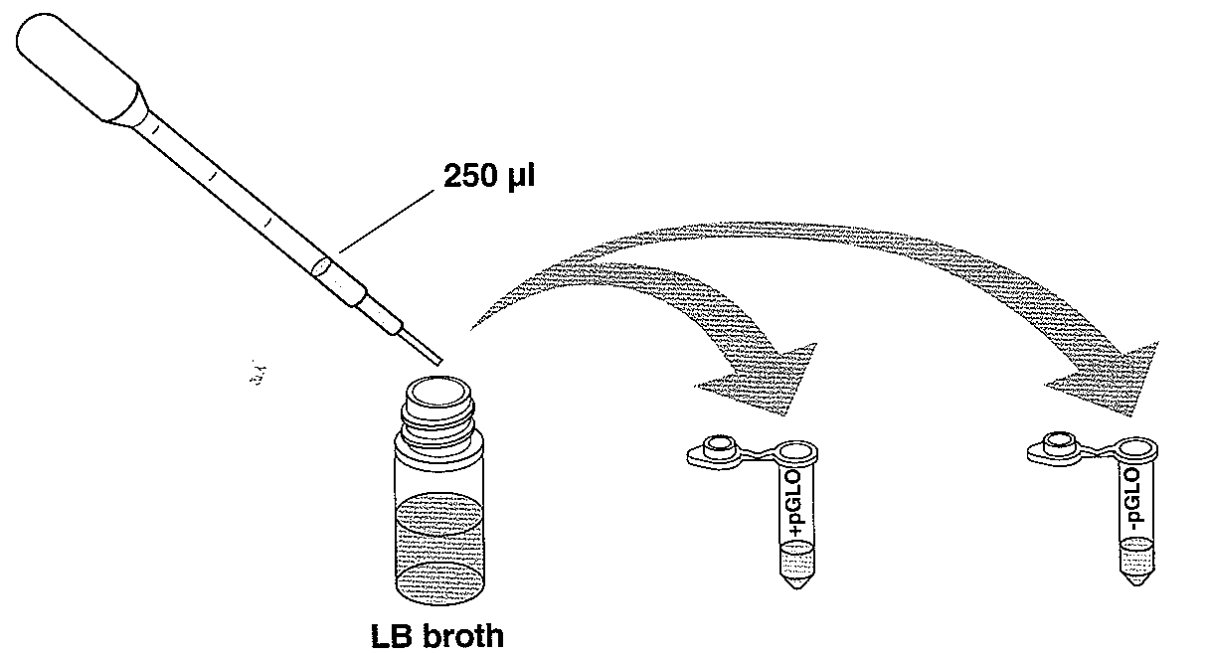
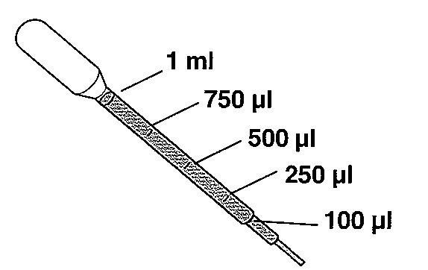
Transformation solution (CaCl₂)
Use sterile pipette to
add 250µL transformation
solution to pGLO + and – tubes

Slide 11
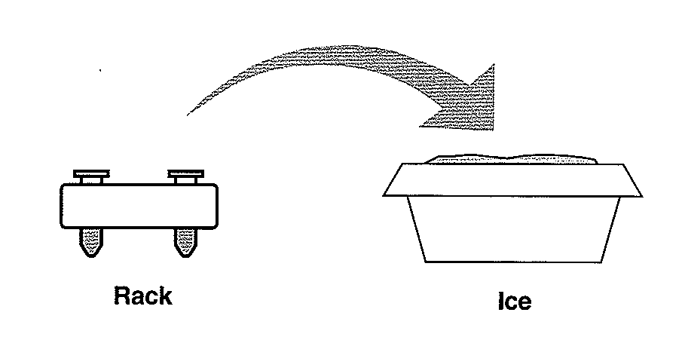
Keep your plasmid on ice!

Slide 12
INNOCULATE TUBES WITH E. coli BACTERIA
Pick one colony Twirl loop in +pGLO tube
Get new loop Pick one colony Twirl loop in –pGLO tube
USE SPECIAL GARBAGE BAG FOR DISPOSAL OF USED LOOPS

Slide 13
EXAMINE pGLO plasmid DNA
Use UV light to examine pGLO plasmid vial
UV light can be harmful to your eyes! Wear your goggles. Do not shine in eyes.
GFP = Green Fluorescent Protein
isolated from jellyfish
USED AS A GENETIC TOOL
http://www.mshri.on.ca/nagy/GFP%20mice.jpg

Slide 14
PLASMID DNA TRANSFER
THIS STEP IS CRUCIAL!
Look closely to make sure you have a film of solution across the ring.
(Similar to soapy film when you blow bubbles)
ADD PLASMID TO + TUBE
DO NOT ADD PLASMID TO - TUBE

Slide 15
YOUR PLATES-
control treatment(s)???

Slide 16
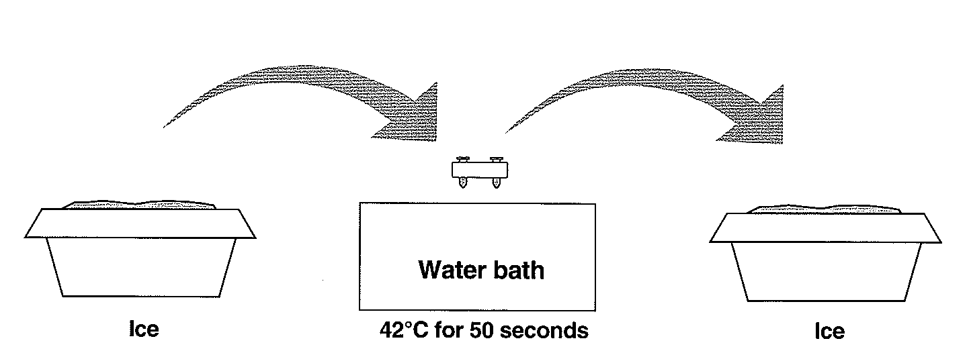
SHOCKING INCREASES UPTAKE OF FOREIGN DNA (PLASMID)
OSMOTIC SHOCK =Transforming solution
CaCl₂
HEAT SHOCK RAPID TEMPERATURE CHANGE is the key
50 SECONDS
2 MINUTES

Slide 17
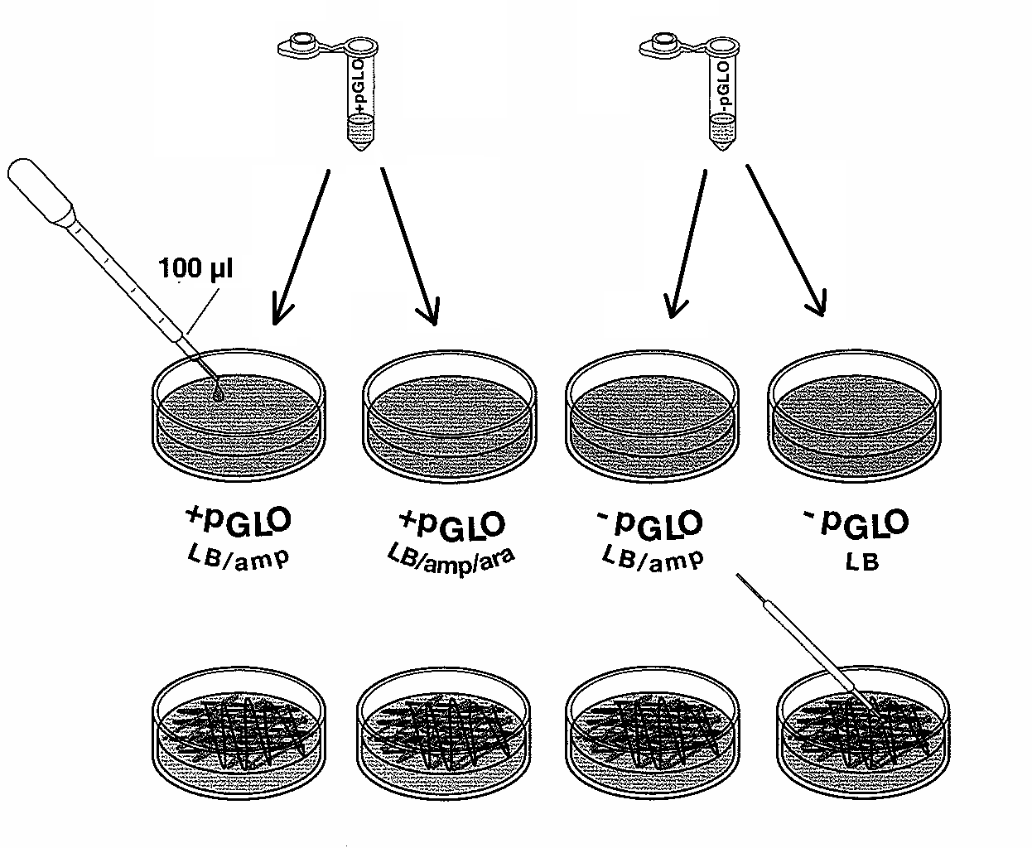
TAP WITH FINGER TO MIX!
Use NEW STERILE pipette for each vial
to add 100 uL bacterial suspension
to CORRECT DISH
(CHECK LABELS!)
Use a NEW STERILE LOOP FOR EACH PLATE
to spread suspension evenly on surface of plate
DO NOT DIG INTO AGAR!
QUICKLY REPLACE LIDS

Slide 18
FLIP PLATES UPSIDE DOWN STACK AND TAPE LABEL WITH YOUR GROUP NAME PLACE IN INCUBATOR

Slide 19
pGLO plasmid
ARABINOSE OPERON
(INDUCIBLE)
Turns on when arabinose sugar is present
Allows bacteria to digest this sugar
Ori-
Plasmid
Replication
genes
araC
ori
pGLO
GFP
GFP-Green Fluorescent Protein
- Glows green in fluorescent light
bla
bla (beta-lactamase)
- On all time
- Makes protein that breaks down ampicillin
- Provides ampicillin resistance

Slide 21
Inducible operon: lactose
Digestive pathway model
GLUCOSE is food of choice
Don’t need lactose digesting enzymes
Gene is turned off
RNA
polymerase
TATA
repressor
gene1
gene2
gene3
gene4
DNA
promoter
operator
repressor
ACTIVE repressor protein

Slide 22
Inducible operon: lactose
Slide from Kim Foglia
lac
lac
Digestive pathway model
When lactose is present, binds to lac repressor protein & triggers repressor to release DNA
induces transcription
lac
lac
lac
lac
lac
RNA
polymerase
lac
repressor
gene1
gene2
gene3
gene4
TATA
DNA
mRNA
1
2
3
4
enzyme1
enzyme2
enzyme3
enzyme4
promoter
operator
repressor
repressor protein
lac
lactose
conformational change in repressor protein makes it
INACTIVE!
lactose – repressor protein
complex
lac
repressor

Slide 23
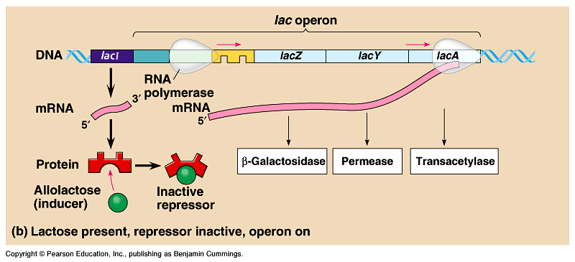
Lactose operon
What happens when lactose is present?
Need to make lactose-digesting enzymes
Lactose is allosteric regulator of repressor protein

Slide 24
Reasons for Each Transformation Step
Ca⁺⁺
CaCl₂ treatment
Positive charge of Ca⁺² ions neutralizes:
negative charge of DNA phosphates
negative charge of membrane phospholipids
O
Ca⁺⁺
O
P
O
Base
O
CH₂
O
Sugar
O
Ca⁺⁺
O
P
O
Base
O
CH₂
O
Sugar
OH

Slide 25
Reasons for Each Transformation Step
Incubation on ice slows fluidity cell membranes
Heat-shock increases permeability of cell membrane
Nutrient broth incubation allows beta lactamase expression

Slide 26
Selection for plasmid uptake
Antibiotic becomes a selecting agent
only bacteria with the plasmid will grow on antibiotic (ampicillin) plate
only transformed bacteria grow
all bacteria grow
a
a
a
a
a
a
a
a
a
a
a
a
a
a
a
a
a
LB plate
LB/amp plate
cloning

Slide 27
Transformation Results
LB PLATE Luria Broth
+
- PGLO = NO Plasmid
→
All cells grow since there is no antibiotic on the plate

Slide 28
Transformation Results
LB/AMP PLATE Luria Broth with antibiotic
+
- PGLO = NO plasmid
→
NO GROWTH Cells without plasmid don’t have antibiotic resistance. Can’t grow on media with antibiotic added.

Slide 29
Transformation Results
LB/AMP PLATE Luria Broth with antibiotic
+
+ PGLO = Plasmid added
→
LAWN Cells with plasmid have antibiotic resistance gene so can grow on media with antibiotic

Slide 30
Transformation Results
LB/AMP/ARA PLATE Luria Broth + antibiotic| + arabinose
+
+ PGLO = Plasmid added
Cells with pGLO plasmid GROW & GLOW -can grow on media with antibiotic
GLOW on media with arabinose (turns on GFP gene)
→

Slide 32
+pGLO LB/amp
+pGLO LB/amp/ara
-pGLO LB/amp
-pGLO LB
http://faculty.clintoncc.suny.edu/faculty/michael.gregory/files/Bio%20101/Bio%20101%20Laboratory/Bacterial%20Transformation/results.htm

